Slide 1
Real Time Control Module and Hydraulic Controls

Slide 2
Workshop No. 7 Objectives
Learn the capability of, and how to use the Real Time Control (RTC) module
Direct Flow Control
Valve/Gate Control
Pump Control
Learn how to use the hydraulic flow controls in the base package including:
Regulator

Slide 3
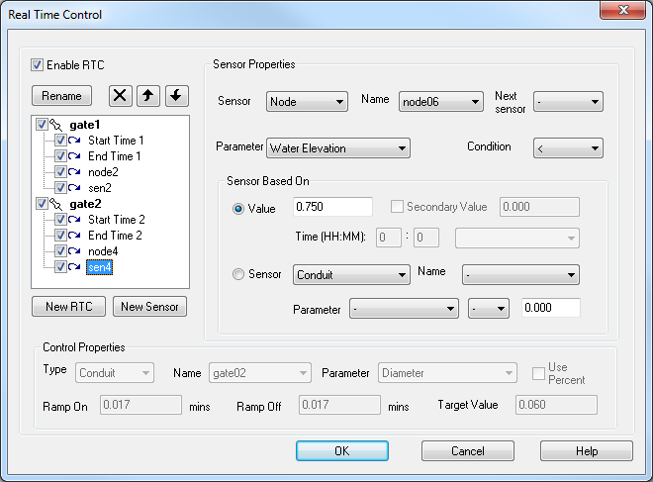
RTC Add-on Module
This tool is accessed from the Configuration Menu if enabled in the license configuration
It expands the existing (depth only) flow controls to a comprehensive management tool

Slide 4
Multiple Controls and Sensors
Real-time control consists of two components; the real-time control element and one or more sensors used to control this element
Definition of RTC Elements
Properties of each RTC Sensor
Properties of RTC Controls

Slide 5
RTC Controls
Element | Parameter
Conduit | Flow, Roughness, Diameter (or Depth)
Node | Depth, Elevation
Pump | On/Off Elevation, Speed Factor, Pump Flow Rate, Well Volume
Weir | Flow, Crest Elevation, Surcharge Elevation, Length, Discharge Coefficient
Orifice | Area, Discharge Coefficient
Rating Curve | Flow
Notes:
5

Slide 6
RTC Controls
Each Control has a set of Sensors
Tree structure in the dialog used for setting order and organizing the group of controls
Multiple objects can have specified Controls
Object selection by picking from a list
Target can be a Fixed Value or a Percentage
Ramp On/Off time in minutes to alter the speed

Slide 7
RTC Sensors
Sensor | Parameter
Conduit | Flow, Velocity
Node | Water Depth, Water Surface Elevation
Pump | Pump Flow Rate
Weir | Flow Rate
Orifice | Flow Rate, Velocity
Time | Simulation Time, Time of Day, Month (Jan-Dec), Day (Mon-Sun), Even/Odd Day
Notes:
7

Slide 8
RTC Sensors
Sensors are associated with a control and indented in the tree structure below each control
Multiple sensors can be applied for each control
Boolean logic can be used for multiple sensors (IF, OR etc.)
Sensors can be based on measured objective (head, flow etc.) but can also be based on other sensors
Secondary values can be applied to imply a range of operation for the control
Date/Time sensors allow a scheduling type of control (irrigation, etc.)

Slide 9
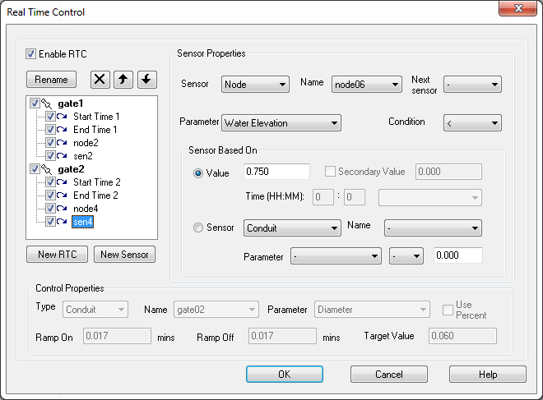
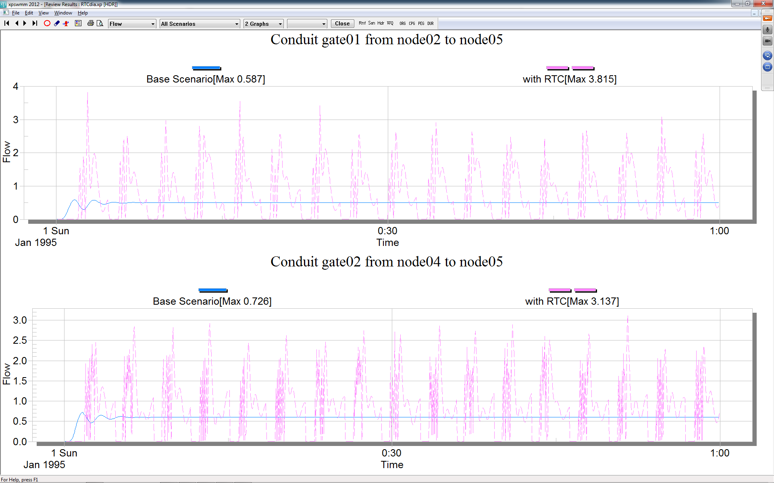
RTC Sample

Slide 10
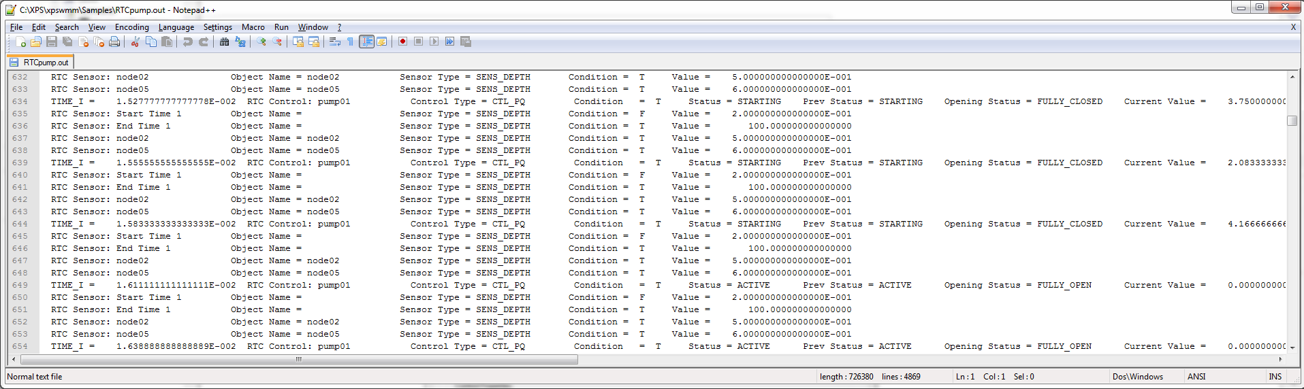
RTC Log
When using the configuration parameter RTC_LOG the software will log the status of all controls and sensors at each time step
Notes:
10

Slide 11
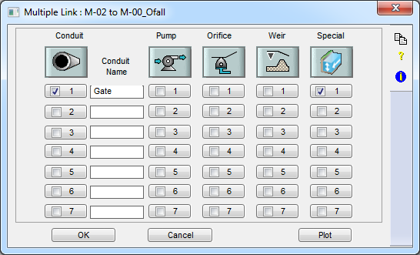
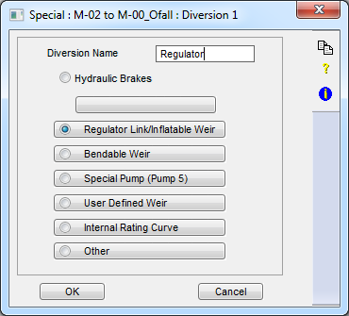
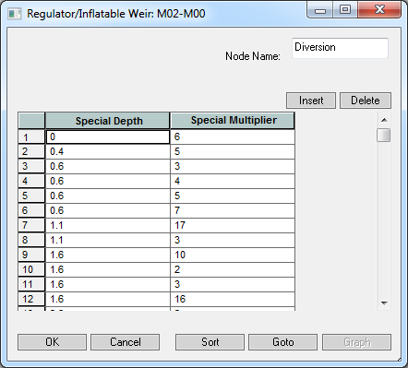
Depth Based Controls
Multilink->Special
Control flow in a link or pump based on depth at any node

Slide 12

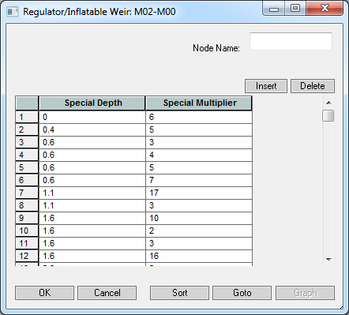
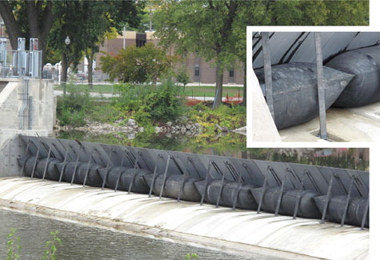
Regulator Link
Rule & flow multiplier applied to the conduit on the same row
1 allows full flow in the conduit and 0 stops flow (fully closed)
Values between 0 and 1 allow partial flow
Use any node in the model
Inflatable Weir

Slide 13

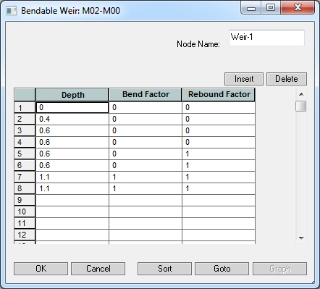
Bendable Weir
Bendable weirs collapse with high Q and rebound with low Q
Usually divert water to treatment plant in combined sewers
Bend factor of 0 is no flow and a value of 1 is to allow flow
Rebound factor of 1 is to stay collapsed and 0 is rebound
Notes:
The model reads the Bend factor as it increases in depth and rebound factor as it decreases

Slide 14
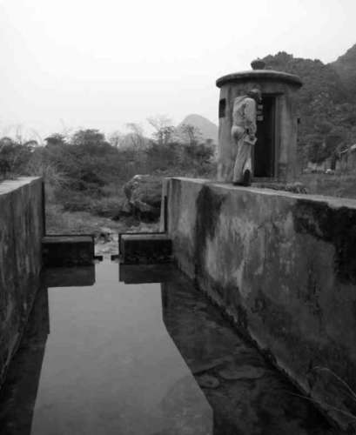
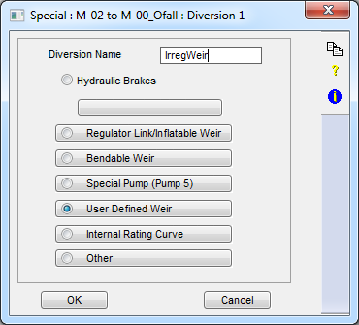
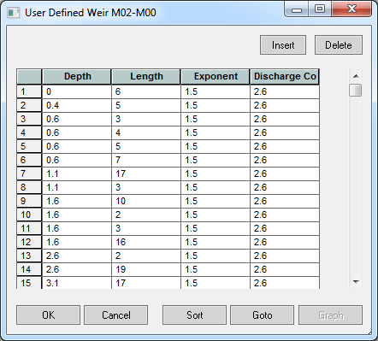
User-Defined Weir
Create a table of depth vs. Length, Exponent and Coefficient
Used for v-notch and trapezoidal and compound weirs

Slide 15
Review & Discuss
Objectives
RTC Module Description and examples
Special dialog for some conduit controls based on node depth
Applications

Slide 16
Demonstration

